Slide 1
Helm The package manager for Kubernetes
From zero to hero
Daniel Hasselwander

Slide 2


Goals for this session
What is helm
Why it is useful
Alternatives
Concepts from Helm

Slide 3





Helm - Profile
Package Manager for k8s
Config-Files YAML
CNCF
Written in Go
Notes:
Package Manager for Kubernetes like Package manager Npm, nuget etc.
Maintaned by Helm Community
Consists of 2 parts Client Software and Library

Slide 4
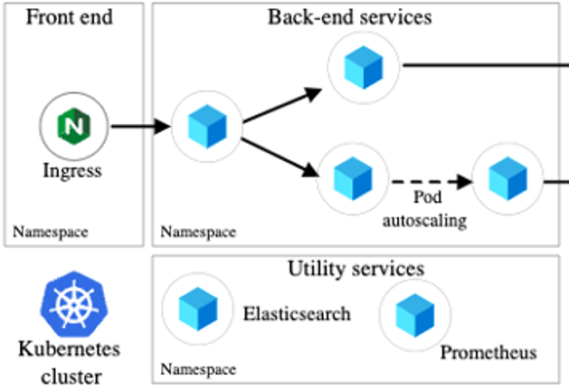
Kubernetes application
Notes:
Deploy a product with a lot of ressources can be make pain
Create a release ?

Slide 5
Kubernetes application
Kubernetes Ressourcen
2 Namespaces
1 Ingress
4 Deployments
1 HPA
Notes:
Deploy a product with a lot of ressources can be make pain
Create a release ?

Slide 6

How we can manage this ?

Slide 7
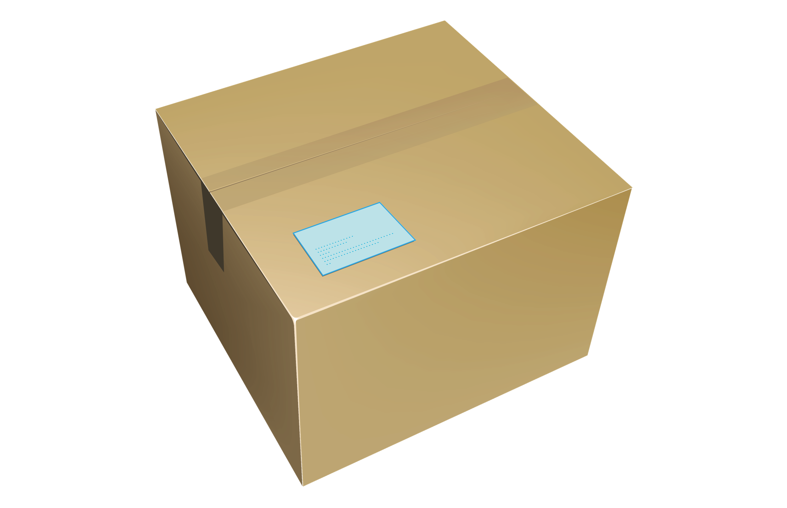
Kubernetes application
Helm
App
Notes:
Deploy a product with a lot of ressources can be make pain
Create a release ?

Slide 8

Why you should use Helm
Manage K8s Complexity
Simple Sharing
Test your App
Easy Rollbacks
Notes:
Single Source of Truth
Which Components you need
Simple Sharing Applications only Install with Helm
It is a Share medium for our applications
Rollbacks to old release version are really easy

Slide 9

Do you know alternatives to deploy applications in k8s like modules or packages ?
Notes:
Deploy a product with a lot of ressources can be make pain
Create a release ?

Slide 10

Microsoft Bicep
Notes:
Nur weil man kann muss man das nicht machen. Terraform kann keine Tests. Releases Rollback

Slide 11
Helm – Alternatives – My Opinion
Helm is best practice for k8s packages
Helm can test your App really running
Use Terraform outside your cluster and helm inside
Notes:
Helm and Logo
Package Manager for Kubernetes like Package manager Npm, nuget etc.
Maintaned by Helm Community
2 Parts Client Software and Library
The Helm Library provides the logic for executing all Helm operations. It interfaces with the Kubernetes API server and provides the following capability:
Combining a chart and configuration to build a release
Installing charts into Kubernetes, and providing the subsequent release object
Upgrading and uninstalling charts by interacting with Kubernetes
The standalone Helm library encapsulates the Helm logic so that it can be leveraged by different clients.
Client command-line client for end users
Local chart development
Managing repositories
Managing releases
Interfacing with the Helm library
Sending charts to be installed
Requesting upgrading or uninstalling of existing releases

Slide 12
Helm Structure
Helm CLI
Helm Library
Notes:
Helm and Logo
Package Manager for Kubernetes like Package manager Npm, nuget etc.
Maintaned by Helm Community
2 Parts Client Software and Library
The Helm Library provides the logic for executing all Helm operations. It interfaces with the Kubernetes API server and provides the following capability:
Combining a chart and configuration to build a release
Installing charts into Kubernetes, and providing the subsequent release object
Upgrading and uninstalling charts by interacting with Kubernetes
The standalone Helm library encapsulates the Helm logic so that it can be leveraged by different clients.
Client command-line client for end users
Local chart development
Managing repositories
Managing releases
Interfacing with the Helm library
Sending charts to be installed
Requesting upgrading or uninstalling of existing releases

Slide 13
Work with Helm – Processes
Notes:
Helm and Logo
Package Manager for Kubernetes like Package manager Npm, nuget etc.
Maintaned by Helm Community
2 Parts Client Software and Library
The Helm Library provides the logic for executing all Helm operations. It interfaces with the Kubernetes API server and provides the following capability:
Combining a chart and configuration to build a release
Installing charts into Kubernetes, and providing the subsequent release object
Upgrading and uninstalling charts by interacting with Kubernetes
The standalone Helm library encapsulates the Helm logic so that it can be leveraged by different clients.
Client command-line client for end users
Local chart development
Managing repositories
Managing releases
Interfacing with the Helm library
Sending charts to be installed
Requesting upgrading or uninstalling of existing releases

Slide 14
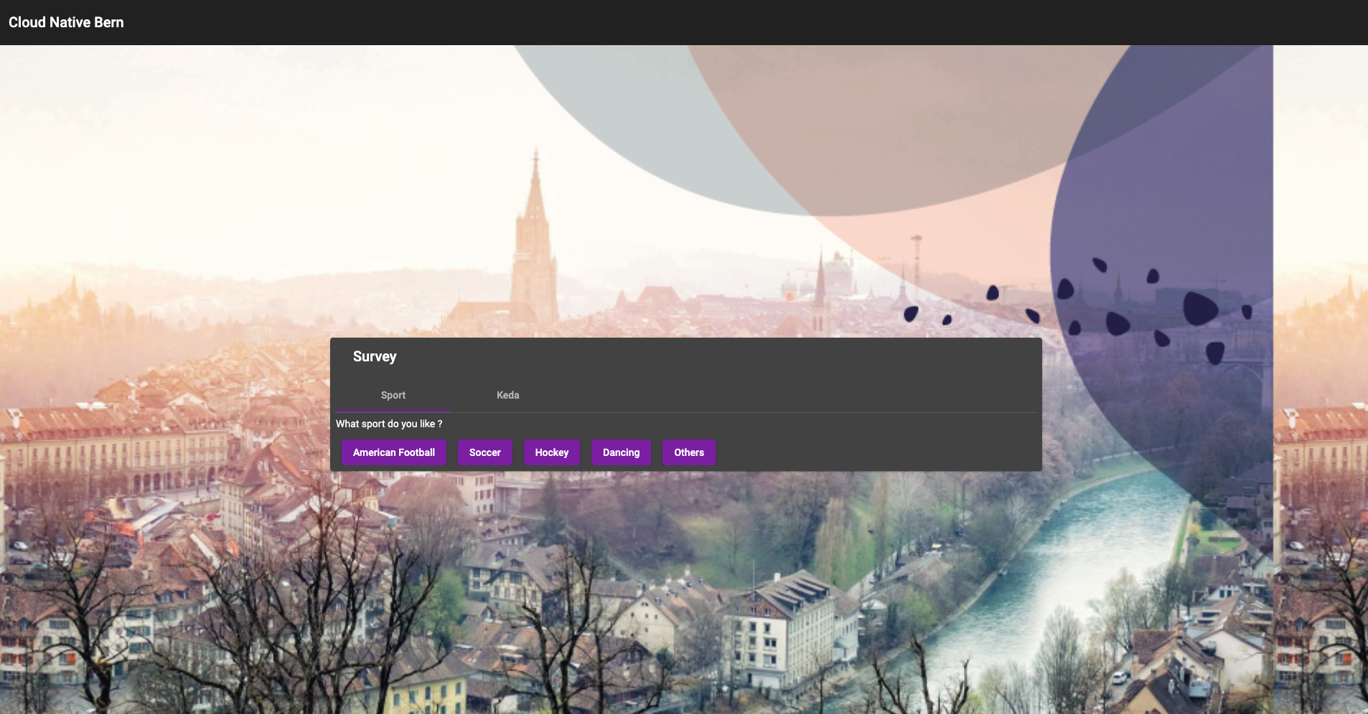
Work with Helm – Processes – Start with App
Frontend
+
Backend
+
DB
Notes:
Deploy a product with a lot of ressources can be make pain
Create a release ?

Slide 15
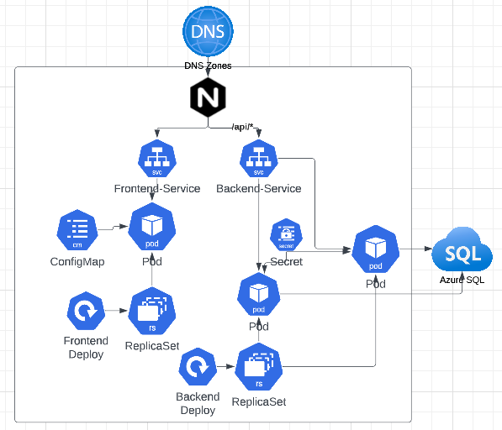
Work with Helm – Processes – Start with App
Notes:
Deploy a product with a lot of ressources can be make pain
Create a release ?

Slide 16
Work with Helm – Processes – Start with App
1xIngress
2xServices
1xDeployment
1xSecret
1xConfigMap
Notes:
Deploy a product with a lot of ressources can be make pain
Create a release ?

Slide 17
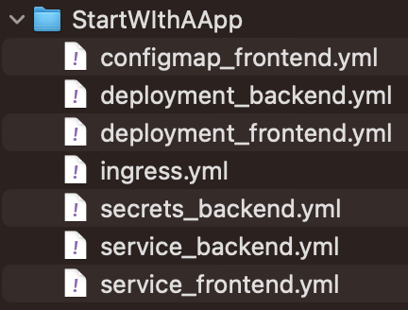
Work with Helm – Processes – Start with App
Needed K8 Resources
1xIngress
2xServices
1xDeployment
1xSecret
1xConfigMap
Create yml-files
Notes:
Deploy a product with a lot of ressources can be make pain
Create a release ?

Slide 18
Helm – Development
Notes:
Client command-line client for end users
Local chart development
Managing repositories
Managing releases
Interfacing with the Helm library
Sending charts to be installed
Requesting upgrading or uninstalling of existing releases

Slide 19
Helm – Development
Chart
Helm CLI
create
push
Notes:
CLI chart = Templates Files
Local chart development
Managing repositories
Managing releases
Interfacing with the Helm library
Sending charts to be installed
Requesting upgrading or uninstalling of existing releases

Slide 20
Helm – Chart - Definition
Helm uses a packaging format called charts
A chart is a collection of files that describe a related set of Kubernetes resources
Comparable like a class in C# or Java
Notes:
CLI chart = Templates Files
Local chart development
Managing repositories
Managing releases
Interfacing with the Helm library
Sending charts to be installed
Requesting upgrading or uninstalling of existing releases

Slide 21
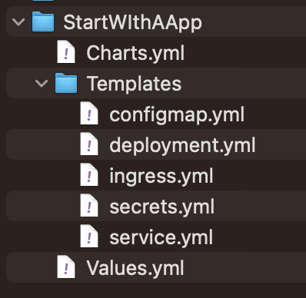
Helm – Chart - Definition
general file (name of chart)
Abstraction of resources that you will deploy
input variable
Charts
Templates
Values
Notes:
CLI chart = Templates Files
Local chart development
Managing repositories
Managing releases
Interfacing with the Helm library
Sending charts to be installed
Requesting upgrading or uninstalling of existing releases

Slide 22
Helm – Development
Chart
Helm CLI
create
Notes:
CLI chart = Templates Files
Local chart development
Managing repositories
Managing releases
Interfacing with the Helm library
Sending charts to be installed
Requesting upgrading or uninstalling of existing releases

Slide 23
Helm – Development
Chart
Repository
Helm CLI
Helm CLI
create
push
Notes:
CLI chart = Templates Files
Local chart development
Managing repositories
Managing releases
Interfacing with the Helm library
Sending charts to be installed
Requesting upgrading or uninstalling of existing releases

Slide 24
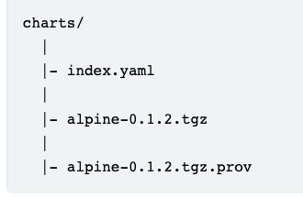
Helm – Repository
A chart repository is an reachable folder that houses an index file and some chart optionally packaged charts
community Helm chart repository is Artifact Hub = docker hub
Notes:
CLI chart = Templates Files
Local chart development
Managing repositories
Managing releases
Interfacing with the Helm library
Sending charts to be installed
Requesting upgrading or uninstalling of existing releases

Slide 25
Helm – Development
Registry
Chart
Repository
Helm CLI
Helm CLI
create
push
Notes:
CLI chart = Templates Files
Local chart development
Managing repositories
Managing releases
Interfacing with the Helm library
Sending charts to be installed
Requesting upgrading or uninstalling of existing releases

Slide 26
Helm Registries
Registry
Repository
Repository
Notes:
CLI chart = Templates Files
Local chart development
Managing repositories
Managing releases
Interfacing with the Helm library
Sending charts to be installed
Requesting upgrading or uninstalling of existing releases

Slide 27
Helm – Registry
A registry store zero or more helm repositories
Notes:
CLI chart = Templates Files
Local chart development
Managing repositories
Managing releases
Interfacing with the Helm library
Sending charts to be installed
Requesting upgrading or uninstalling of existing releases

Slide 28
Work with Helm – Process
Development Charts
Deployment/Interaction with K8s
Notes:
Helm and Logo
Package Manager for Kubernetes like Package manager Npm, nuget etc.
Maintaned by Helm Community
2 Parts Client Software and Library
The Helm Library provides the logic for executing all Helm operations. It interfaces with the Kubernetes API server and provides the following capability:
Combining a chart and configuration to build a release
Installing charts into Kubernetes, and providing the subsequent release object
Upgrading and uninstalling charts by interacting with Kubernetes
The standalone Helm library encapsulates the Helm logic so that it can be leveraged by different clients.
Client command-line client for end users
Local chart development
Managing repositories
Managing releases
Interfacing with the Helm library
Sending charts to be installed
Requesting upgrading or uninstalling of existing releases

Slide 29
Helm – Deployment
Repository
Helm CLI
Helm Library
Input
Release
install
+
Notes:
The Helm Library provides the logic for executing all Helm operations. It interfaces with the Kubernetes API server and provides the following capability:
Combining a chart and configuration to build a release
Installing charts into Kubernetes, and providing the subsequent release object
Upgrading and uninstalling charts by interacting with Kubernetes
The standalone Helm library encapsulates the Helm logic so that it can be leveraged by different clients.
Interfacing with the Helm library
Sending charts to be installed
Requesting upgrading or uninstalling of existing releases

Slide 30
Helm – Chart - Definition
Chart
Release
Templates + Values
Notes:
CLI chart = Templates Files
Local chart development
Managing repositories
Managing releases
Interfacing with the Helm library
Sending charts to be installed
Requesting upgrading or uninstalling of existing releases

Slide 31
Helm – Release
Like a Object in C# or Java
What you really deploy
Notes:
CLI chart = Templates Files
Local chart development
Managing repositories
Managing releases
Interfacing with the Helm library
Sending charts to be installed
Requesting upgrading or uninstalling of existing releases

Slide 32
Helm – Deployment
Release
Kubernetes Cluster
Helm Library
K8s API
Notes:
The Helm Library provides the logic for executing all Helm operations. It interfaces with the Kubernetes API server and provides the following capability:
Combining a chart and configuration to build a release
Installing charts into Kubernetes, and providing the subsequent release object
Upgrading and uninstalling charts by interacting with Kubernetes
The standalone Helm library encapsulates the Helm logic so that it can be leveraged by different clients.
Interfacing with the Helm library
Sending charts to be installed
Requesting upgrading or uninstalling of existing releases

Slide 33
Work with Helm – Process
Development
= CLI
Deployment/Interaction with K8s
= Library
Notes:
Helm and Logo
Package Manager for Kubernetes like Package manager Npm, nuget etc.
Maintaned by Helm Community
2 Parts Client Software and Library
The Helm Library provides the logic for executing all Helm operations. It interfaces with the Kubernetes API server and provides the following capability:
Combining a chart and configuration to build a release
Installing charts into Kubernetes, and providing the subsequent release object
Upgrading and uninstalling charts by interacting with Kubernetes
The standalone Helm library encapsulates the Helm logic so that it can be leveraged by different clients.
Client command-line client for end users
Local chart development
Managing repositories
Managing releases
Interfacing with the Helm library
Sending charts to be installed
Requesting upgrading or uninstalling of existing releases

Slide 34
Work with Helm – Quiz – Time
https://forms.gle/huSxmKbrnvtpUtM78
Notes:
Helm and Logo
Package Manager for Kubernetes like Package manager Npm, nuget etc.
Maintaned by Helm Community
2 Parts Client Software and Library
The Helm Library provides the logic for executing all Helm operations. It interfaces with the Kubernetes API server and provides the following capability:
Combining a chart and configuration to build a release
Installing charts into Kubernetes, and providing the subsequent release object
Upgrading and uninstalling charts by interacting with Kubernetes
The standalone Helm library encapsulates the Helm logic so that it can be leveraged by different clients.
Client command-line client for end users
Local chart development
Managing repositories
Managing releases
Interfacing with the Helm library
Sending charts to be installed
Requesting upgrading or uninstalling of existing releases

Slide 35
1. What are benefits of using helm ?
Notes:
Helm and Logo
Package Manager for Kubernetes like Package manager Npm, nuget etc.
Maintaned by Helm Community
2 Parts Client Software and Library
The Helm Library provides the logic for executing all Helm operations. It interfaces with the Kubernetes API server and provides the following capability:
Combining a chart and configuration to build a release
Installing charts into Kubernetes, and providing the subsequent release object
Upgrading and uninstalling charts by interacting with Kubernetes
The standalone Helm library encapsulates the Helm logic so that it can be leveraged by different clients.
Client command-line client for end users
Local chart development
Managing repositories
Managing releases
Interfacing with the Helm library
Sending charts to be installed
Requesting upgrading or uninstalling of existing releases

Slide 36
1. What are benefits of using helm ?
Manage K8s Complexity
Simple Sharing
Test your App
Easy Rollbacks
Notes:
Helm and Logo
Package Manager for Kubernetes like Package manager Npm, nuget etc.
Maintaned by Helm Community
2 Parts Client Software and Library
The Helm Library provides the logic for executing all Helm operations. It interfaces with the Kubernetes API server and provides the following capability:
Combining a chart and configuration to build a release
Installing charts into Kubernetes, and providing the subsequent release object
Upgrading and uninstalling charts by interacting with Kubernetes
The standalone Helm library encapsulates the Helm logic so that it can be leveraged by different clients.
Client command-line client for end users
Local chart development
Managing repositories
Managing releases
Interfacing with the Helm library
Sending charts to be installed
Requesting upgrading or uninstalling of existing releases

Slide 37
2. Describe what is a helm chart and what is release ?
Notes:
Helm and Logo
Package Manager for Kubernetes like Package manager Npm, nuget etc.
Maintaned by Helm Community
2 Parts Client Software and Library
The Helm Library provides the logic for executing all Helm operations. It interfaces with the Kubernetes API server and provides the following capability:
Combining a chart and configuration to build a release
Installing charts into Kubernetes, and providing the subsequent release object
Upgrading and uninstalling charts by interacting with Kubernetes
The standalone Helm library encapsulates the Helm logic so that it can be leveraged by different clients.
Client command-line client for end users
Local chart development
Managing repositories
Managing releases
Interfacing with the Helm library
Sending charts to be installed
Requesting upgrading or uninstalling of existing releases

Slide 38
2. What are benefits of using helm ?
chart
collection of files that describe a related set of Kubernetes resources like a class in C# or Java
release
Like a Object in C# or Java
What you really deploy
Notes:
Helm and Logo
Package Manager for Kubernetes like Package manager Npm, nuget etc.
Maintaned by Helm Community
2 Parts Client Software and Library
The Helm Library provides the logic for executing all Helm operations. It interfaces with the Kubernetes API server and provides the following capability:
Combining a chart and configuration to build a release
Installing charts into Kubernetes, and providing the subsequent release object
Upgrading and uninstalling charts by interacting with Kubernetes
The standalone Helm library encapsulates the Helm logic so that it can be leveraged by different clients.
Client command-line client for end users
Local chart development
Managing repositories
Managing releases
Interfacing with the Helm library
Sending charts to be installed
Requesting upgrading or uninstalling of existing releases

Slide 39
2.What are competitor products of helm?
Notes:
Helm and Logo
Package Manager for Kubernetes like Package manager Npm, nuget etc.
Maintaned by Helm Community
2 Parts Client Software and Library
The Helm Library provides the logic for executing all Helm operations. It interfaces with the Kubernetes API server and provides the following capability:
Combining a chart and configuration to build a release
Installing charts into Kubernetes, and providing the subsequent release object
Upgrading and uninstalling charts by interacting with Kubernetes
The standalone Helm library encapsulates the Helm logic so that it can be leveraged by different clients.
Client command-line client for end users
Local chart development
Managing repositories
Managing releases
Interfacing with the Helm library
Sending charts to be installed
Requesting upgrading or uninstalling of existing releases

Slide 40
Go's New Brand - The Go Programming Language
Helm
Cloud Native Computing Foundation (cncf.io)
Microservices architecture on AKS - Azure Architecture Center | Microsoft Learn

